Slide 1

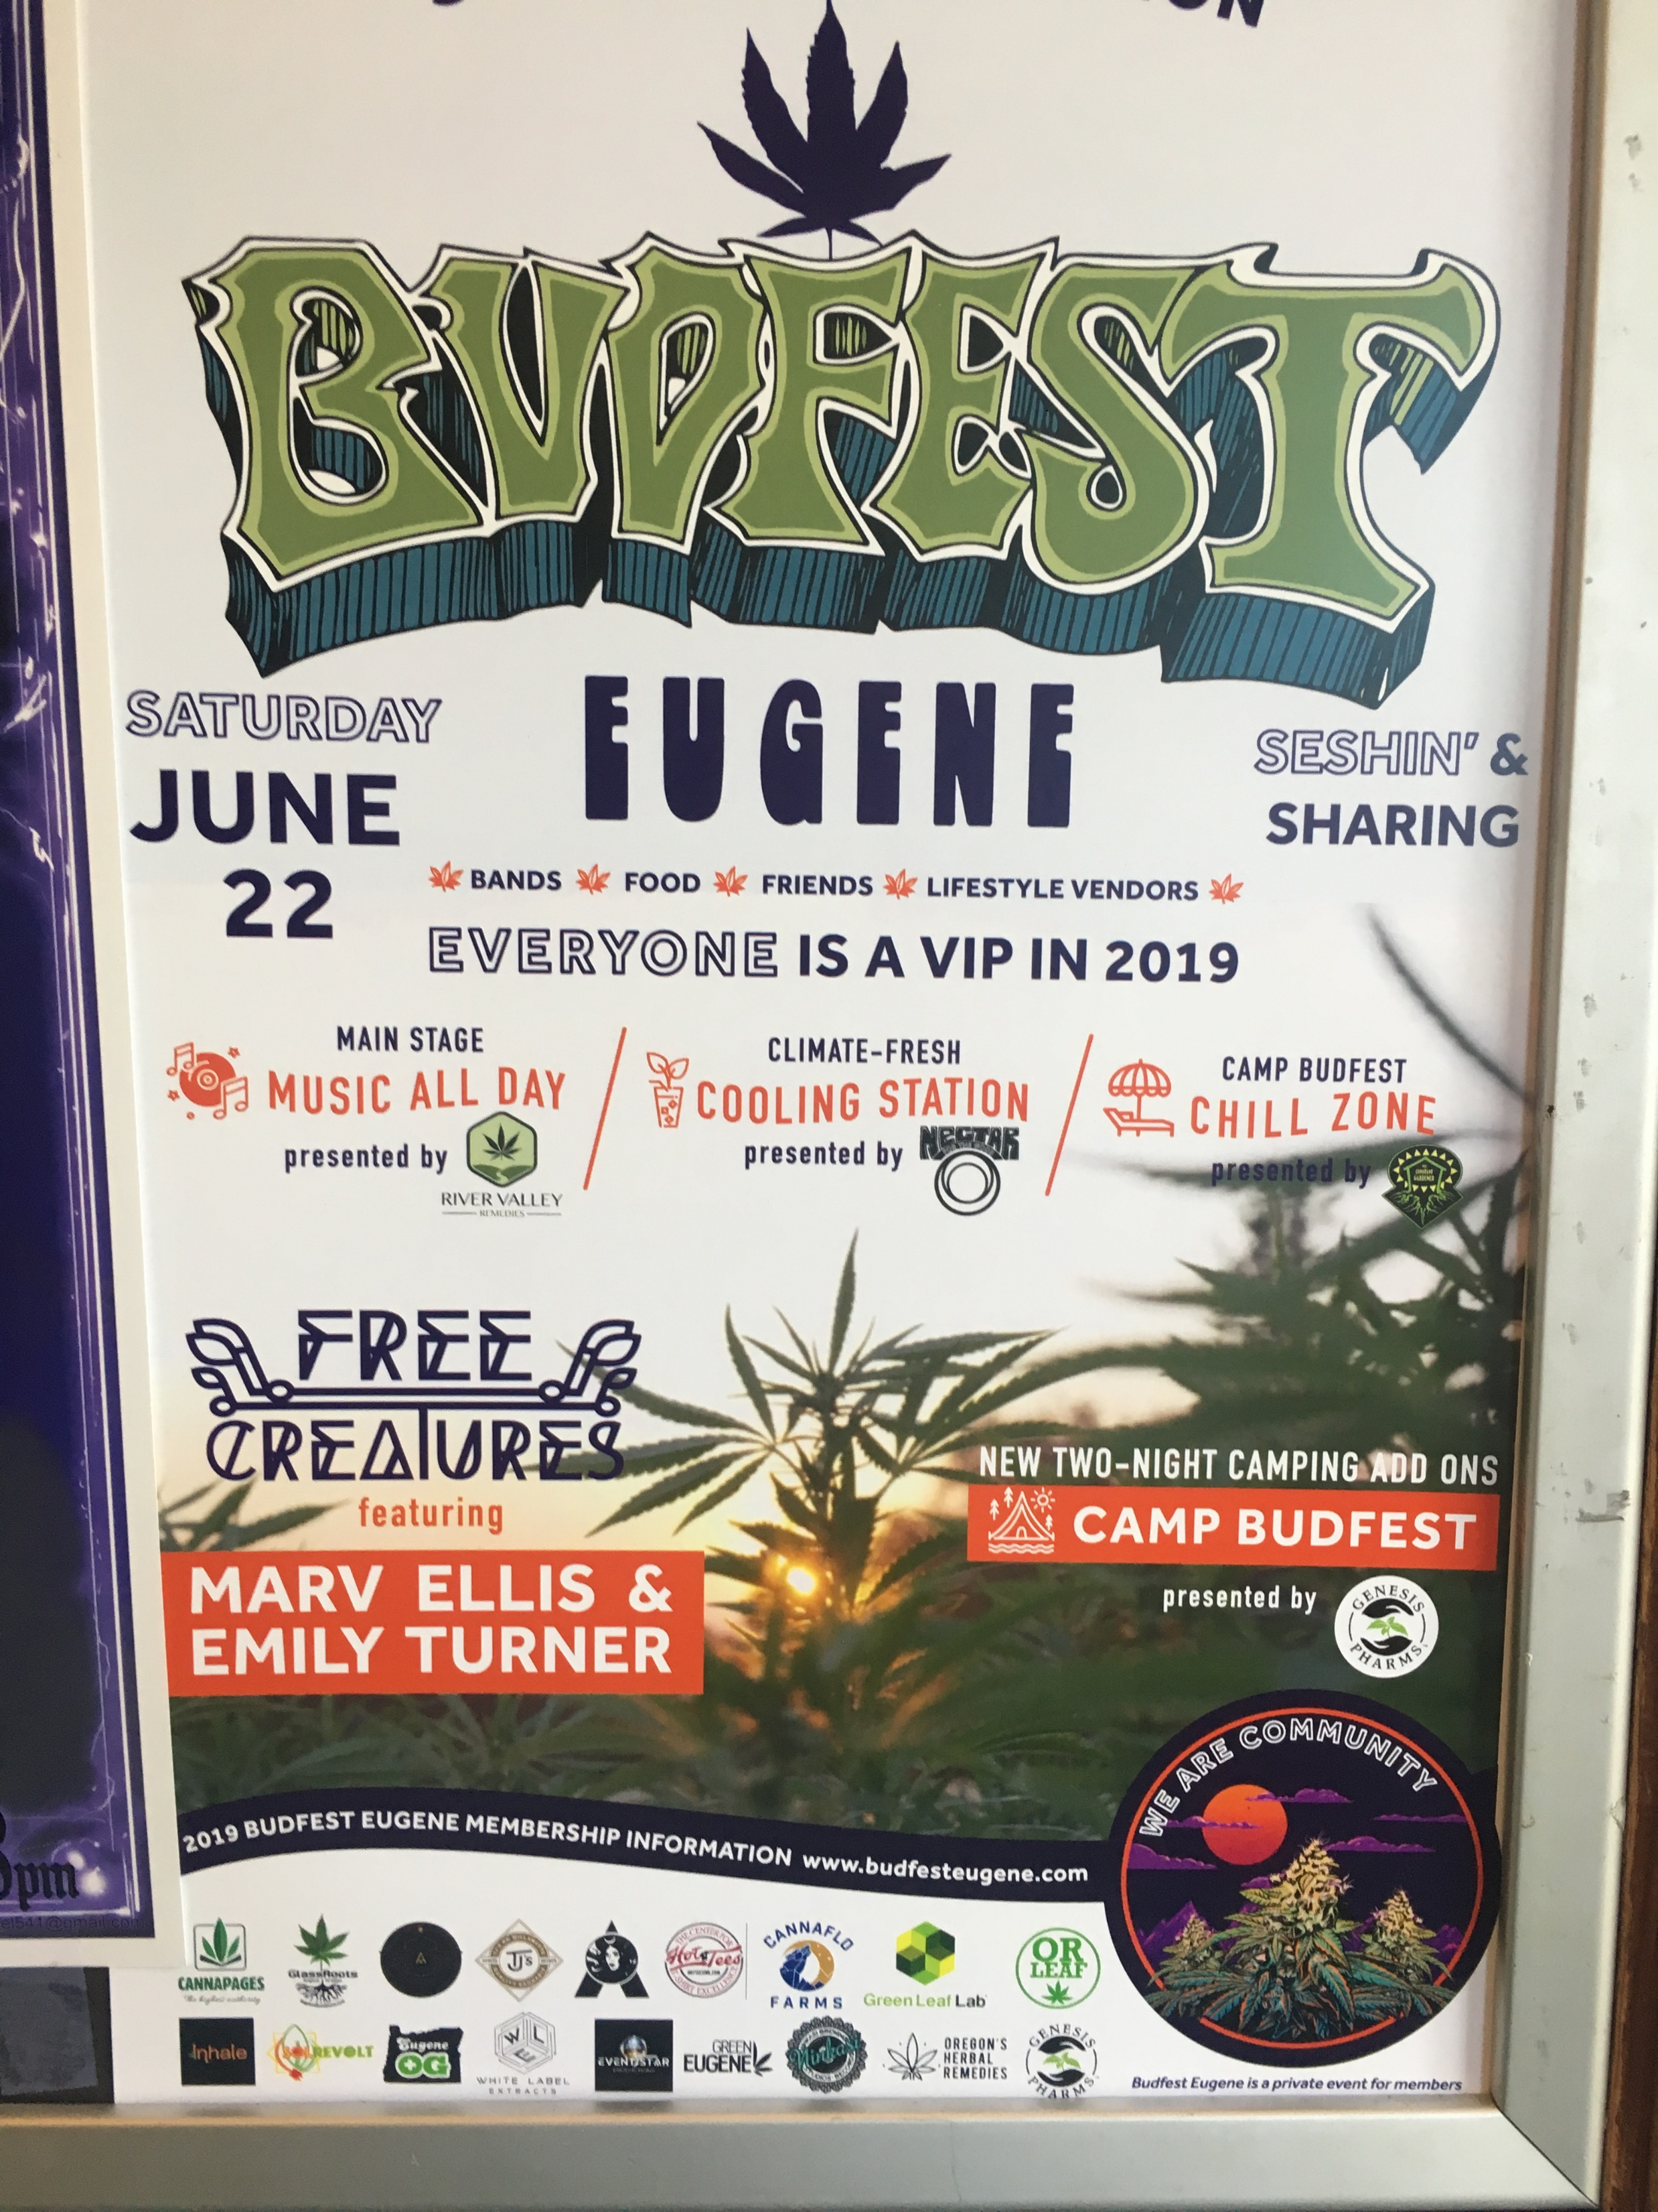

Slide 2


Eric Geisler, M.D.
ABAM, ABFP
Medical Director
Serenity Lane Drug and Alcohol Treatment Center

Slide 3
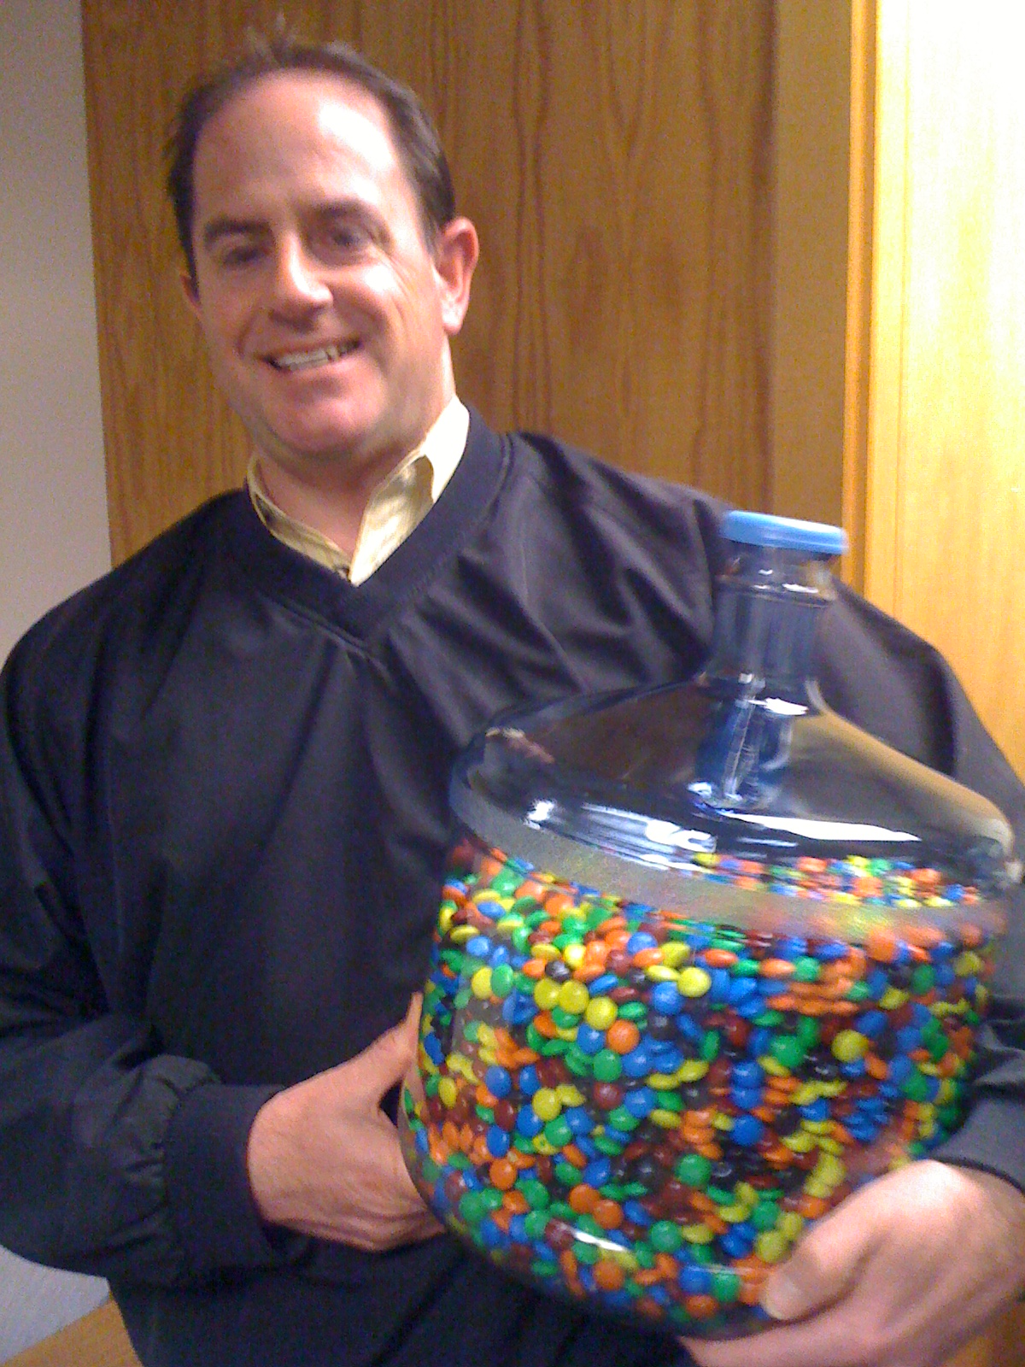

Slide 4
Objectives:
Define A gateway drug

Slide 5
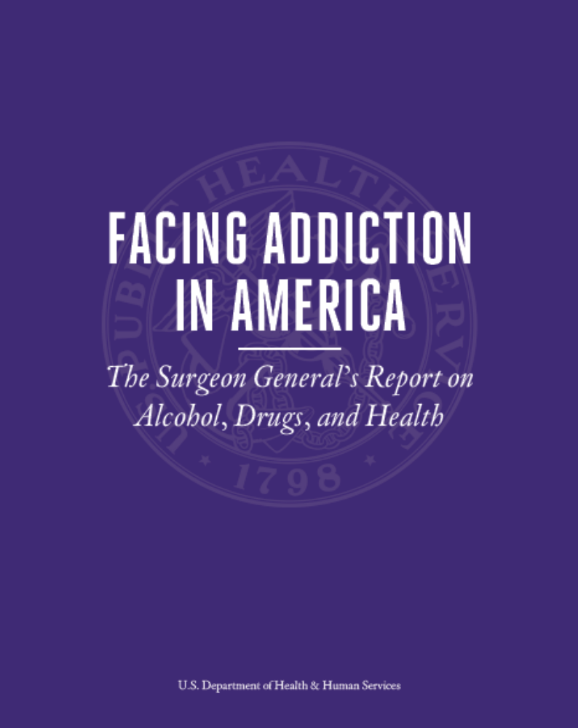

Slide 6
Nicotine Vaping
2018 Surgeon Generals Warning
25% all 18-25 year olds
Massive increase in 2 years

Slide 7
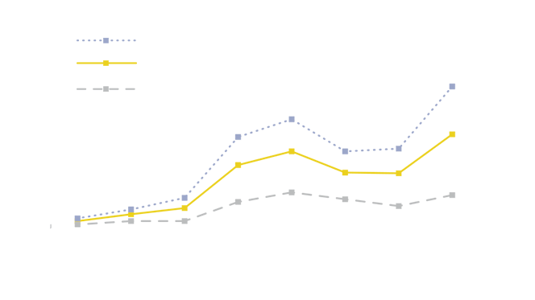

Slide 8
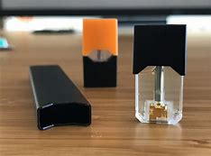
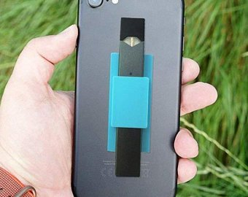
Products & Marketing

Slide 9
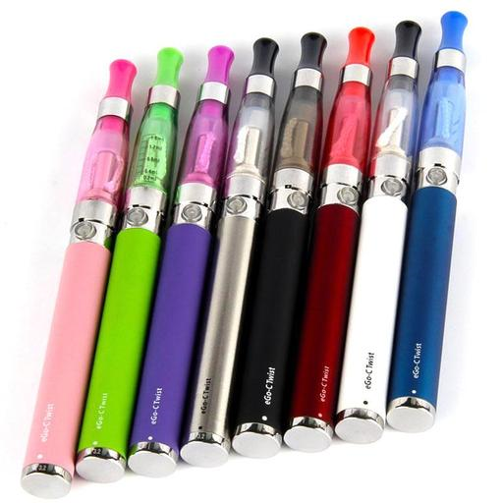
Refillable

Slide 10
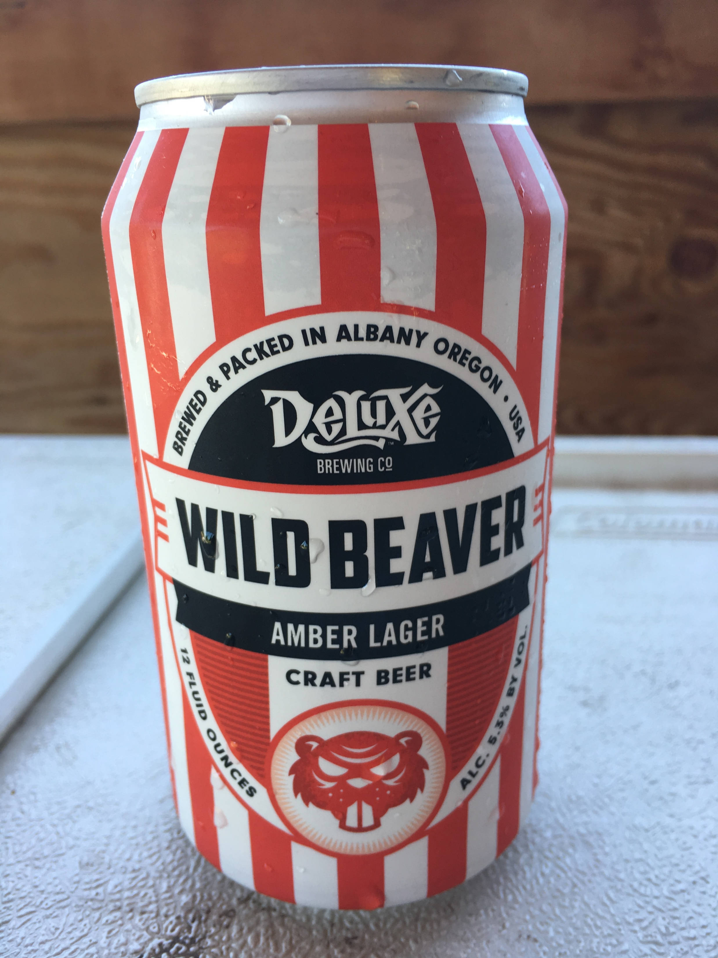
Alcohol is still KING

Slide 11
60%
Admissions to
Serenity Lane Alcohol is Primary
Leading Cause of death of all substances
Mostly MVA and Trauma

Slide 12
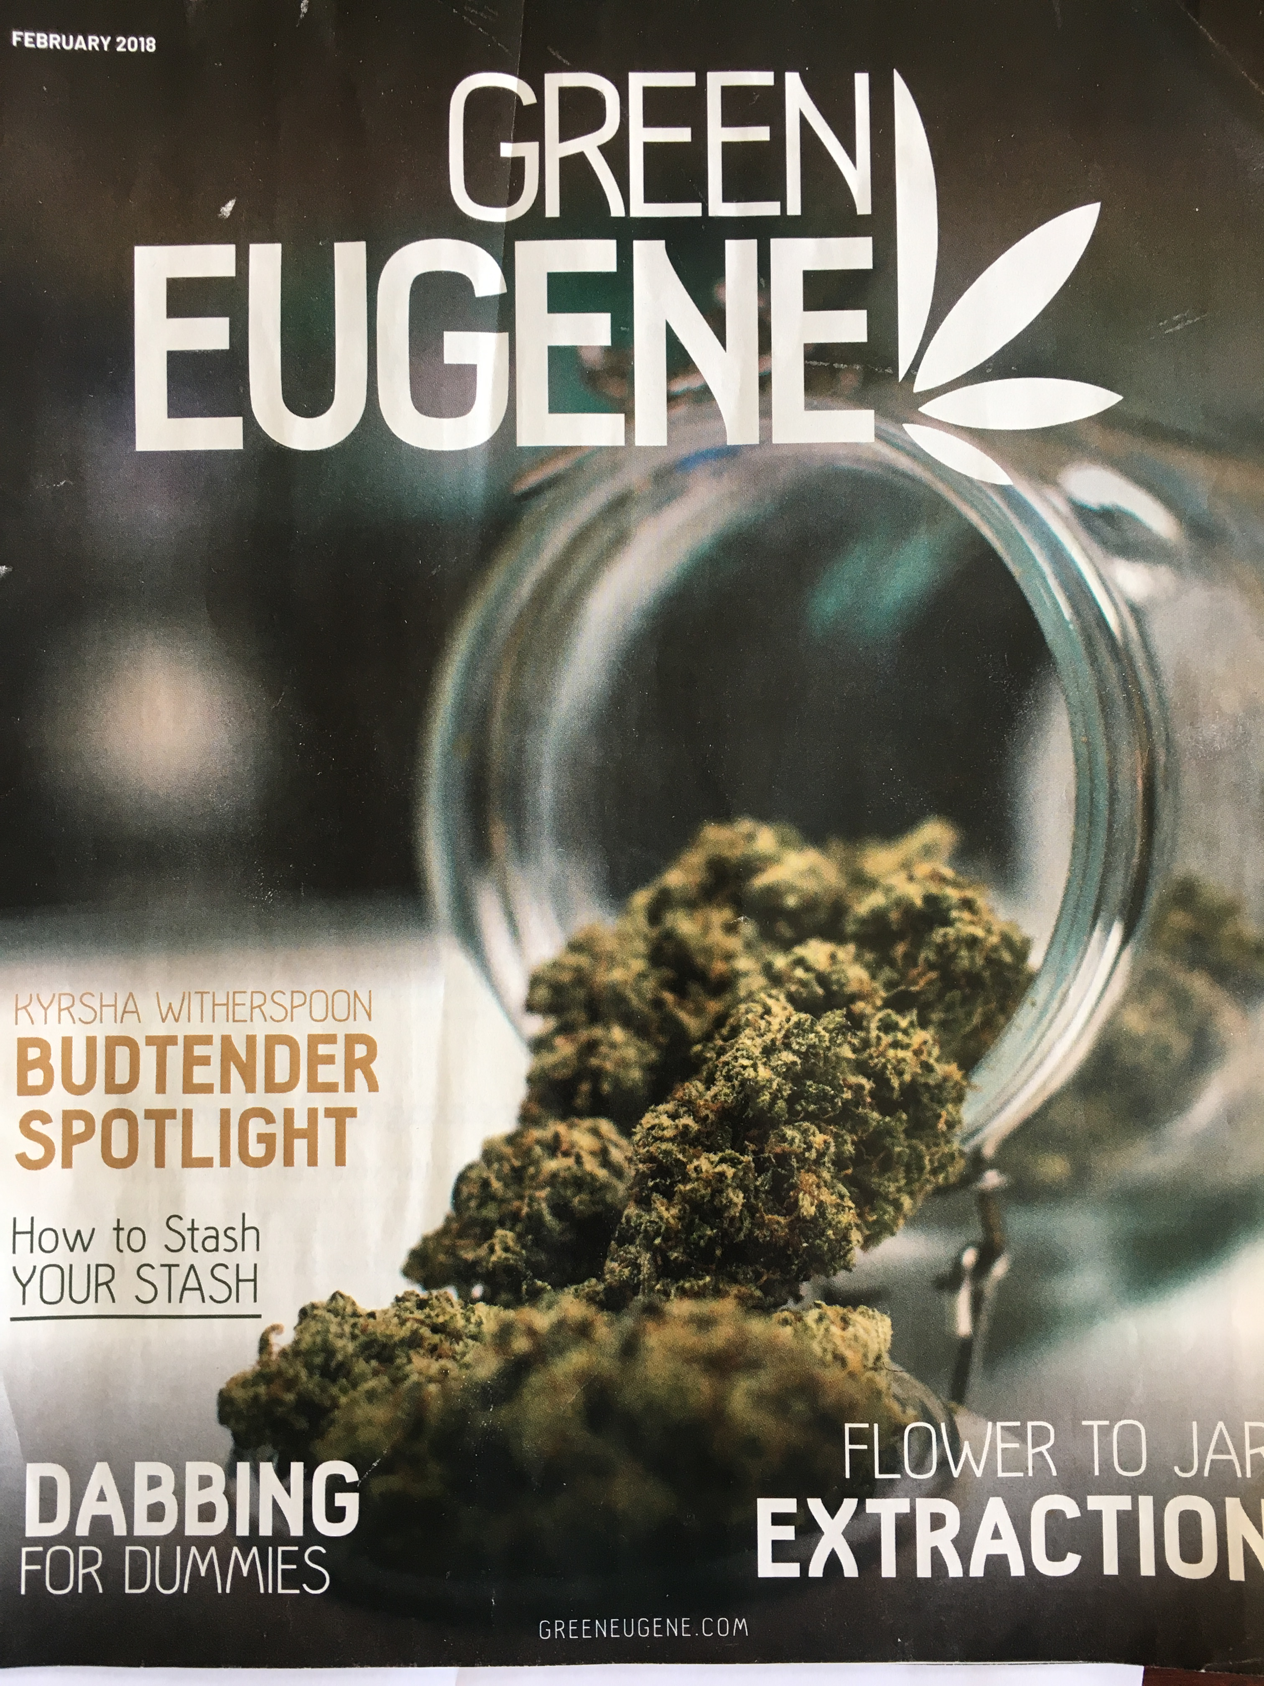

Slide 13
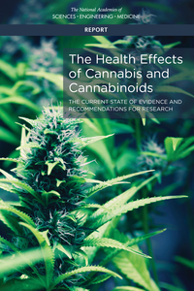

Slide 14
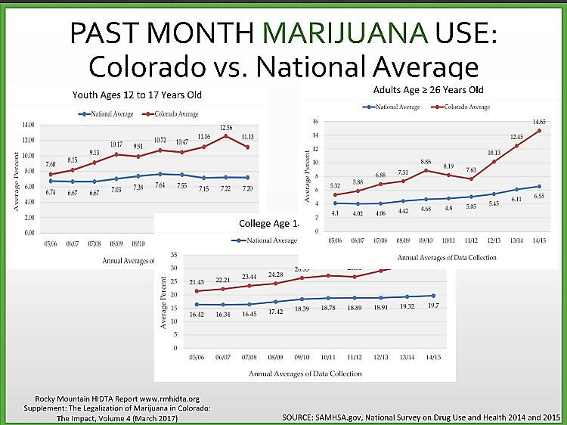

Slide 15
Marijuana
THC relaxation, decrease anxiety, euphoria
CBD pain reduction
UDS - 50 ng/ml
LCMS – 20 ng/ml
5 day half life 600 300 150 75 37.5 = 20 days

Slide 16
Flower
33 % THC max
Sensamillam
Indicas
Hemp
ONE Gram joint 20% THC 20 % absorbed = 40 mg
40000000 ng/
70 kg = 70 L = 70000 ml
= 563 ng/ml

Slide 17
Marijuana Extracts
Shatter, Dabbs, wax
CO2 extraction
Butane
Liquid solvent
Vap Pens 98% THC oil

Slide 18

Edibles
THC 350mg Bar
350 mg = 350000000 ng / 70 kg = 70l = 70000ml5000 ng/ ml
50% absorbed----10% survives first pass in liver = 2250 ng/ml
First pass saturation, second cookie = 5000ng BLAST!

Slide 19
Branding:
Grape Ape Ultimate Train wreck
Diabalo White Widow
Blue Diesel Laughing Buddha

Slide 20
Vaping:
98% extracts
80-90 % absorbed
Minimal metabolism

Slide 21
Effects:
Cyclical Vomiting -- > 1000ng/ml
Acute Psychosis-- > 5000ng/ml
Schizophrenia 3 X baseline
20 Point drop in IQ scores

Slide 22
What is normal social use?
Weddings?
Ball Games?
Relax at end of Day?
What are social costs?
We live in competitive Society

Slide 23
End of Prohibition
Canopy Grow Corporation -- CGC $6 Billion • Constellation Brands, Snoop Dog, Kush Bottling • Acreage Holdings, Chuck Shumer, John Boehner
Aurora Cannabis -- ACBFF -- $3.5 Billion
Cronos Group -- PRMCF -- 1.23 $ Billion
California -- $25 Billion

Slide 24
Opiate Epidemic
Medical Route—legitimately prescribed
Party route
Overdose rate stabilizing, prescription deaths dropping
SL 442 patients last year, 19 completed, 198 still enrolled
Springfield Treatment Center 300 + patients

Slide 25


Slide 26
Drug Early Warning System (DEWS)
Executive office of the President
Office of National Drug Control Policy (ONDCP)
Center for Substance Abuse Research (CESAR)
University of Maryland

Slide 27
CDEWS-DEWS
DEWS provides a relatively quick and inexpensive snapshot of the types of drugs recently used by participating populations and can help the local program to identify important drugs that their testing program may be missing. A major innovation of the current study is the expansion of the CDEWS testing panel from 169 to more than 240 licit and illicit substances, including opioids, benzodiazepines, antidepressants, and new psychoactive substances (NPS). The CDEWS methodology has been implemented in nineteen sites and the results are contained in nine reports already released by the Office of National Drug Control Policy (NDEWS, 2018).

Slide 28
DEWS-ODNCP-CESAR
https://ndews.umd.edu/resources/cdews-reports
103 Consecutive Urine Samples December 2017-February 2018
61 % Methamphetamine
47 % MJ
35 % Opiates
31 % POLY 4 or more
8 % Kratom
3 % Fentanyl
0 % Synthetic Cannabinoids - K2, Spice

Slide 29
Unique to Lane County
A set of comparisons of methamphetamine positive and negative specimens revealed that in both younger and older persons, non-fentanyl opioids, likely stemming from heroin use, were almost 3 times more common in methamphetamine positive specimens than methamphetamine negative specimens.
Future research might examine why and how these persons seeking supervised withdrawal from drugs were using methamphetamine and heroin and how their use may have led them to pursue treatment.

Slide 30
Gateway to what ?

