Slide 1

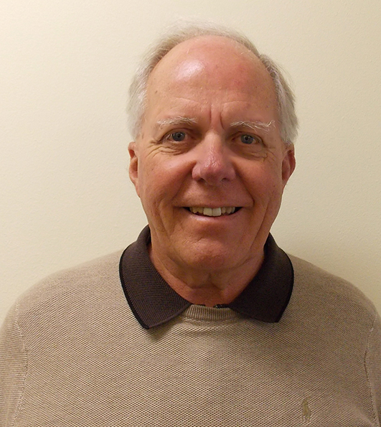
The Impact of Legalized
Marijuana in the Workplace
Presented by:
Jerry Gjesvold BS
December 5, 2019
Manager of Employer Services
Serenity Lane Health Services
541-917-7453

Slide 2
PAST

Slide 3
Prior to 1998
Most employers simply stated in their policies that if THC was present in the urine it was a disciplinary event since Marijuana was an illegal substance.

Slide 4
Disconnect
The disconnect is between Federal and State Laws regarding the use of Marijuana for medical or recreational purposes. Anyone having to comply with Federal laws or regulations can have a zero tolerance for any Marijuana use. Marijuana in still considered a Schedule I drug under Federal law.

Slide 5
My Experience With Employers and Medical Marijuana
1. The card was always presented after the
employee tested positive.
2. The employer in all cases had no policy
statement covering how they would handle
such situations.

Slide 6
Good News
*The Oregon Supreme Court ruled in April of 2010 that employers DO NOT have to accommodate the medical use of Marijuana. There have been no employment decisions rendered for the recreational use.
*Washington State has taken a similar position.

Slide 7
Court Rulings
US Supreme Court Ruling. No recognized medical use for Marijuana. That sentiment is currently being debated due to the benefits reported from CBD’s.
All States with Medical Marijuana Supreme Court decisions have favored the employers.

Slide 8
PRESENT

Slide 9
Medical vs. Recreational Use
of Marijuana
Medical use
In order to use Marijuana medically, the person
must have a “qualifying medical condition”.
Recreational Use
The only requirement for recreational use is
to be at least 21 years old just like alcohol.
Black Market

Slide 10
Frequently Asked Questions
1. Can employers prohibit marijuana
use during work hours.
2. Can employers continue to test for
Marijuana?
3. What about off duty Marijuana
consumption?
4. What about medical Marijuana use
in the workplace?

Slide 11
Problems with Marijuana
THC is fat soluble…
The brain is the fattiest tissue in the body…
Heavy use can lead to thinking errors and difficulty learning and retaining information…
Changes are much more subtle than other drugs…Which in some ways makes it more dangerous…

Slide 12
Reasons to be Concerned
THC levels in Marijuana today. Some of the Butane Honey Oils have concentrations of up to 90+% THC.
The adverse impact the use of the drug will have on the developing brains of adolescents. Good reason to encourage them to wait until age 25 to begin using. DABBING/VAPING.
Recent “vaping illness” and deaths.
Problems with edibles.

Slide 13
Public Sentiment Regarding Legalization of Marijuana
The current public sentiment regarding the legalization of recreational use of Marijuana shifted from slightly over 40% five years ago to just under 64%...Over 90% favor the medical use of Marijuana. Although the outcome of legalization is somewhat unclear, there is reason to be concerned…Future workforce???

Slide 14
Feds vs States
Make no mistake that one of the driving forces making the legalization of Marijuana popular is financial.
Colorado: 2017 sales were $1.5 Billion and tax revenue was over $500 million.
Oregon: Recreational sales the first week were $11 million and the tax revenue the first 2 months exceeded what they expected for the entire year.

Slide 15
The Past 6 Years in America
The medical use of Marijuana is legal in 33 states.
The recreational use of Marijuana is legal in 11 states and the District of Columbia.
Vermont was the first state to recently legalize Marijuana for recreational use through the legislative process. $$$
Law enforcement is starting to use oral fluid
testing to support “current impairment”
when issuing Marijuana DUII’s.

Slide 16
Federally regulated employers are
free to adopt a “zero tolerance”
policy regarding the off duty use
of Marijuana.
DOT
Hospitals-Medicare
Public Agencies
Non Federally regulated employers and licensing boards may want to take a more cautionary approach until things are sorted out as a result of legal challenges

Slide 17
CBD’s, Hemp and THC
One of the issues creating confusion is that science is finding that Marijuana does have some therapeutic/medical benefits. One example is the use of Cannabidiols (CBD’s) in treating seizure disorders and pain(NFL). There are 483 active chemicals in Marijuana.
Legalization of Hemp in all but 2 states. Oklahoma and Idaho. Hemp can contain up to .3% THC.
What this has created is a heated debate in Washington DC to reclassify Marijuana from a Schedule I to a Schedule II drug. Oregon has already done this.

Slide 18
Recent FDA Announcements
Although there has been a great deal of pressure at the Federal level for Marijuana to be rescheduled as a Schedule II drug the FDA recently announced that they were not going to make that change.
At the same time they announced that they were lifting the restrictions regarding the research of Marijuana in America.

Slide 19
Employer/Supervisor Responsibility
Under Federal and State labor laws employers are obligated to maintain a safe work environment for all employees.
Anyone acting as an “agent” for the employer must address employees that present for work and appear to be questionably “fit for duty” for whatever reason.

Slide 20
Symptoms of Possible Marijuana Use
1. Difficulty staying focused on task.
2. Minimizing complacency.
3. Distortion of time and space.
4. Isolating.
5. Confusion.
6. Short and long term memory problems.
7. Disheveled appearance.
8. Inappropriate laughter.

Slide 21
Employers Concern
When an employee is using marijuana medically or recreationally are they “fit for duty”?
Currently science is unable to define when someone using Marijuana is “impaired”

Slide 22
Future
What Should Employers and Health Professional Boards Do???

Slide 23
Challenges
*Unlike alcohol marijuana has no testing regarding being “currently” impaired.
*Until the science catches up, measuring current impairment in the workplace or while driving will be difficult to establish.
*Some employers and unions have indicated
that as soon as they come up with a defendable impairment test they will lift their ban on
“off duty” Marijuana use.

Slide 24
Not So Good News
AFSCME vs Lane County: Terminated employee for medical Marijuana use.
Lane County had the following benefits in this case:
-The employee terminated had a medical
Marijuana card. Oregon Supreme Court ruling.
-The County receives Federal funds.
-Policy stating “zero tolerance”.
Arbitrators decision in June 2016. Reinstate the employee. Pay him $21,500 in lost wages and $8,000.00 in attorneys fees.

Slide 25
More Not So Good News
Johns Hopkins University Medical School Study Regarding Passive Inhalation.
*Mild Contact High.
*Several individuals tested positive above the
50ng. Threshold

Slide 26
Options to Consider
*Maintain a zero tolerance. It would be advisable
to make a statement in your policy to indicate
how you will handle a positive urine screen for
THC.
*Notify employees that the employer is only
concerned about them being “Fit for Duty”.
*Do nothing which is not advisable.

Slide 27
Procedures to Follow
Provide advance notice to the applicant or employee.
Pay for some or all of the testing expenses.
Give the applicant or employee an opportunity to challenge the test results.
Administer the test in a way that minimizes intrusion into their privacy.

Slide 28
The Impairment Issue
Employers and Law Enforcement are prevailing in challenges when they can show documented evidence of symptoms of impairment that are consistent with CURRENT Marijuana intoxication.
One suggestion is to do both an oral fluid AND urine screen at the same time.

Slide 29
Additional Suggestions
That employers have some kind of a strategy before
it comes up. Once it does it can become an emotional issue and that is not a good time to be making costly decisions.
As we move forward there will be more research being done in this country. Try to stay current as
new studies give us more scientific knowledge
about Marijuana and the consequences of its use.

Slide 30
Questions/Discussion

